Slide 1
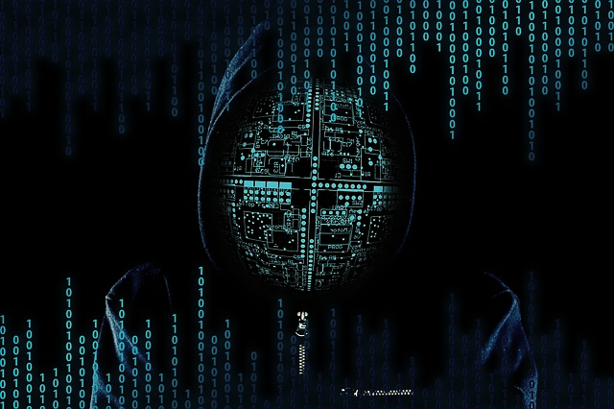

NETAJI SUBHAS INSTITUTE OF TECHNOLOGY, BIHTA
CYBER SECURITY & ETHICAL HACKING
Because "password123" is not a security strategy
PRESENTED BY
RISHABH RANJAN (ROLL NO: 261064) MIRTUNJAY KUMAR (ROLL NO: 261101)
BTECH CSE SECTION B
Notes:
The Big Picture: Cyber security and ethical hacking are often mentioned together, but it is helpful to look at them as two sides of the same coin.
Cyber Security (The Shield): This is the overarching umbrella. It focuses on defense, strategy, and maintenance. It includes setting up firewalls, managing access controls, educating employees, and building defenses to keep unauthorized users out.
Ethical Hacking (The Sword): This is a specialized, proactive discipline within cyber security. Instead of just building the walls, ethical hackers actively test them by trying to scale them, find hidden cracks, or bypass security checks.
The Relationship: You cannot have a robust defense without testing it. Ethical hacking provides the real-world intelligence that cyber security teams need to upgrade their systems and stay ahead of evolving threats.

Slide 2

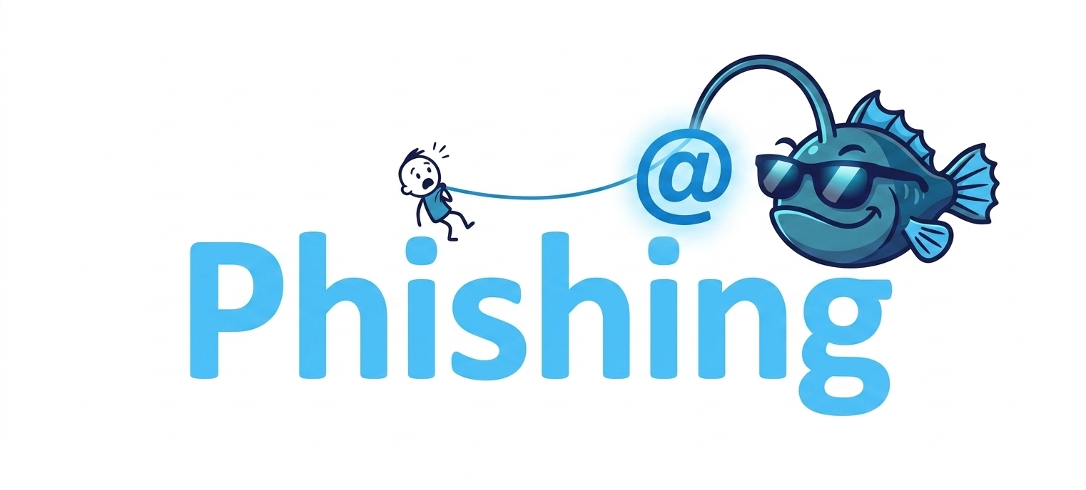
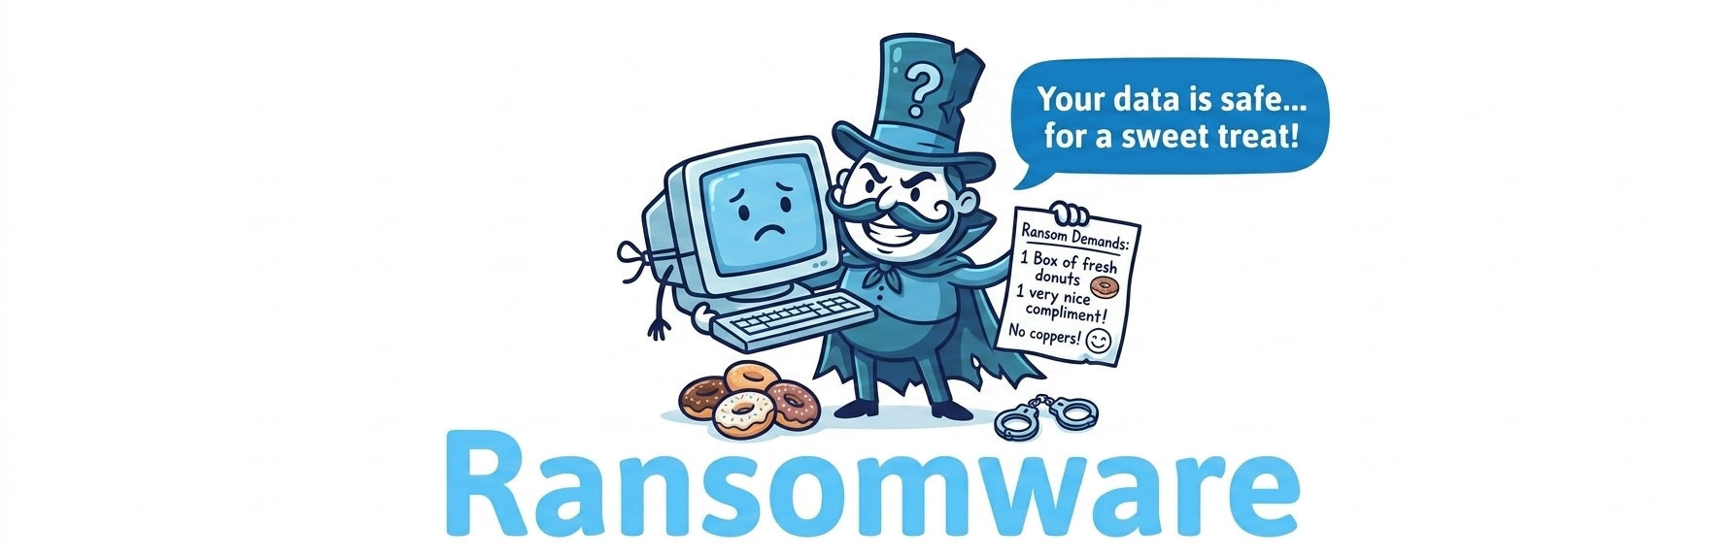
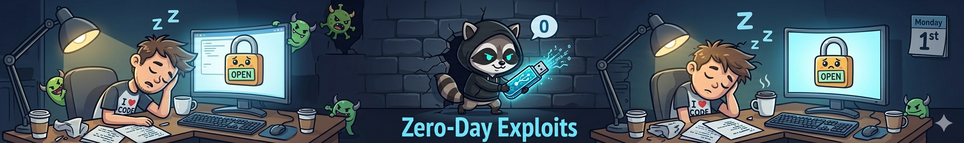





COMMON CYBER THREATS: THE BAD GUYS MENU
Phishing
Ransomware
Zero-Day Exploits
Tricking users into handing over credentials via fake emails disguised as bank updates or college portals.
Malware that encrypts your files and holds your precious college project hostage until crypto is paid.
Attacks exploiting unknown software vulnerabilities before developers even realize they exist.
Notes:
Emphasize how phishing succeeds because human psychology is easier to hack than code.

Slide 3


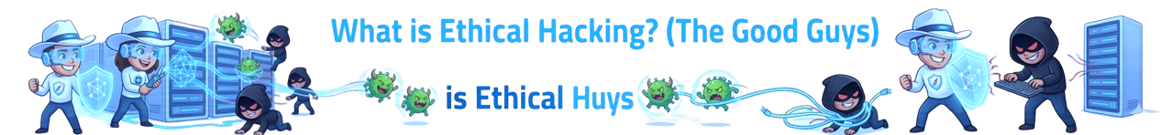
WHAT IS ETHICAL HACKING? (THE GOOD GUYS)
Authorized Intrusion: Hacking with explicit permission to find security holes.
White Hat Mindset: Thinking like a criminal to protect the innocent.
Vulnerability Assessment: Finding bugs before bad actors exploit them.
Legal vs. Illegal
The only difference between a Black Hat hacker and an Ethical Hacker is a signed contract and legal permission (and hopefully less panic when sirens sound).
Notes:
Clarify that ethical hacking requires strict scopes and written consent to avoid jail time.
The Hook: When most people hear the word "hacker," they immediately think of cybercriminals, data breaches, and digital chaos. But today, we are going to look at the other side of the coin: the "good guys."
Definition: Ethical hacking—also known as penetration testing or white-hat hacking—is the practice of legally and deliberately breaking into systems, networks, or applications to find security vulnerabilities.
The Key Difference: The defining difference between an ethical hacker and a cybercriminal boils down to two things: permission and intent. Ethical hackers have explicit written consent from the organization they are testing, and their intent is to fix weaknesses, not exploit them for malicious gain.
Why it Matters: Think of them like digital security guards. To effectively defend a fortress, you have to think exactly like the intruder trying to break in. Ethical hackers help organizations fix their flaws before the "bad guys" can find them.

Slide 4

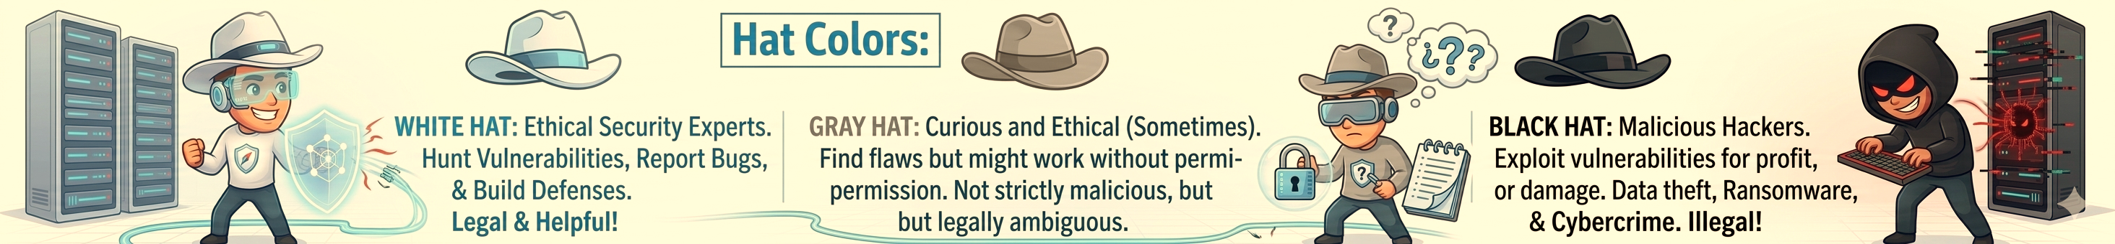
HAT COLORS: WHO IS WHO IN CYBER SPACE?
Hacker Type | Motivation | Legal Status
White Hat | Security enhancement & fixing vulnerabilities | 100% Legal
Black Hat | Malicious intent, financial theft, data breach | Illegal (Criminal)
Grey Hat | Curiosity, minor rules bypassed, public notification | Legally Gray / Illegal

Slide 5



ESSENTIAL TOOLS OF THE TRADE
Kali Linux: The Swiss Army knife operating system for security audits.
Wireshark: Deep package analysis to sniff network traffic.
Metasploit: The standard framework for developing and executing exploit code.
Automation vs Skill
Tools make tasks faster, but true ethical hacking requires deep protocol and logic understanding.
Notes:
: Joke about how installing Kali Linux doesn't instantly make you a Hollywood hacker.
The Delivery: "Now let's talk about Kali Linux—the operating system of choice for ethical hackers. But a quick reality check first..."
The Punchline: "Downloading Kali Linux does not instantly turn you into a Hollywood cyber-pro. It just means you're about five minutes away from accidentally breaking your own Wi-Fi connection while trying to follow a YouTube tutorial."

Slide 6



THE OWASP TOP 10 (WEB APP NIGHTMARES)
The OWASP Top 10 List
Broken Access Control | Insecure Design
Security Misconfiguration | Authentication Failures
Software Supply Chain Failures | Software or Data Integrity Failures
Cryptographic Failures | Security Logging & Alerting Failures
Injection | Mishandling of Exceptional Conditions
Why Developers Fear It
Web applications are exposed to the entire internet 24/7, making them prime targets for automated web crawlers.

Slide 7


SQL INJECTION: THE CLASSIC FLAW
"SELECT * FROM users WHERE username = 'admin' AND password = 'xyz' OR 1=1--"
Notes:
Speaker Note: Explain how poor input sanitization lets attackers trick databases into telling the truth unconditionally.
Talking Points:
The Core Problem: This slide brings us to one of the most famous vulnerabilities in cyber security: SQL Injection, or SQLi. It happens when an application blindly trusts user input without cleaning or "sanitizing" it first.
The Anatomy of a Query: When you log into a website, the backend usually runs a database command that looks like this: "Find a user where username equals X AND password equals Y." The database expects plain text for X and Y.
Tricking the Logic: If the input isn't sanitized, an attacker can input database commands instead of a normal username. A classic trick is typing something like: ' OR 1=1 --.
Telling the Truth Unconditionally: By injecting OR 1=1, the attacker alters the logic of the code. Because the mathematical statement 1=1 is always true, the database evaluates the entire login query as true—unconditionally. It completely bypasses the password check.
The Result: The database opens up and hands over the data, thinking it's fulfilling a perfectly valid, successful request. This is how poor input sanitization completely breaks authentication barriers.

Slide 8





HARDENING THE PERIMETER: DEFENSE STRATEGIES
Strong Auth & MFA
Regular Patching
Security Awareness
Never rely on passwords alone. Multi-Factor Authentication blocks 99% of bulk automated login credential attempts.
Keep software and kernels updated to ensure zero-day vulnerabilities have no room to breathe.
Train employees and users so they stop clicking links in emails offering free pizza.
Notes:
Speaker Note: Remind everyone that humans are often considered the weakest link in security chains.
The Reality Check: We spend billions of dollars globally on firewalls, encryption, zero-trust architectures, and advanced AI detection systems. But none of that hardware matters if a person willingly opens the front door.
The Weakest Link: In cybersecurity, humans are often considered the weakest link in the security chain. It is vastly easier for an attacker to trick a tired, distracted, or curious employee into clicking a malicious link than it is to crack a 256-bit encryption key.
Social Engineering: This brings us to the concept of social engineering—hacking the human instead of the machine. Phishing emails, urgent phone calls pretending to be IT support, or baiting tactics all exploit basic human traits like trust, fear, or a desire to be helpful.
The Solution: Security isn't just an IT problem; it’s a culture problem. A company's defense is only as strong as its least-trained employee, which is why regular awareness training is just as critical as any software patch.

Slide 9


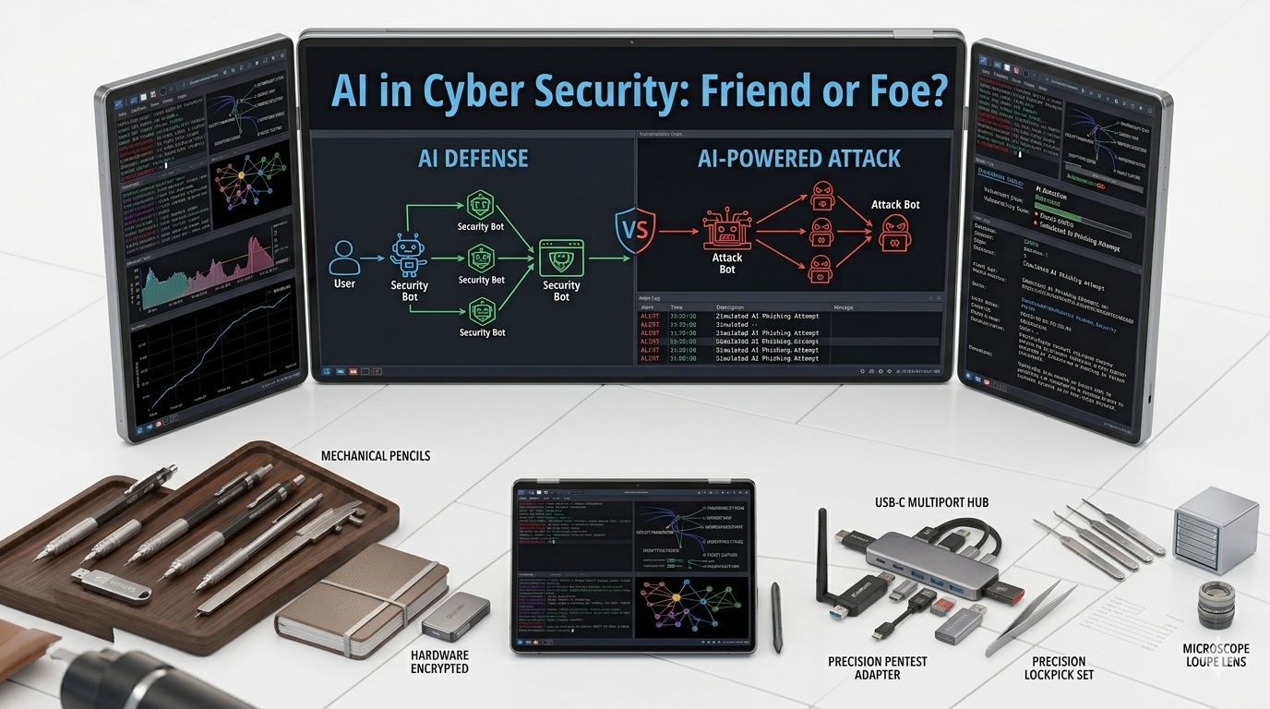
AI IN CYBER SECURITY: FRIEND OR FOE?
Offensive AI: Attackers use machine learning to generate hyper-realistic phishing and automated attack loops.
The Arms Race
Machine learning has accelerated both attacks and defenses, shifting cyber warfare to automated speed.
Defensive AI: Security systems utilize real-time anomaly detection to isolate breaches instantly.
Notes:
Speaker Note: Mention how AI vs AI is the current frontier of digital conflict.
The Evolution: Cybersecurity used to be a battle of human wits—a human attacker trying to find a flaw, and a human defender trying to patch it. Today, the battlefield has fundamentally shifted. We are entering an era of automated warfare, where AI vs. AI is the current frontier of digital conflict.
The Offensive Side (The AI Threat): Malicious actors are leveraging artificial intelligence to scale attacks at an unprecedented pace. They use machine learning to scan thousands of systems simultaneously for vulnerabilities, write mutating malware that evades traditional antivirus programs, and craft hyper-realistic, automated phishing scams tailored to specific targets.
The Defensive Side (The AI Shield): On the flip side, human defenders simply cannot keep up with machine-speed attacks. Cybersecurity teams now deploy defensive AI models that constantly monitor network behavior, predict anomalies, and instantly isolate compromised systems in milliseconds—long before a human analyst could even open an alert.
The Continuous Arms Race: It has become an algorithmic arms race. The side with the smarter, faster, and more adaptable AI algorithm wins.
Transition to next slide:
"With machines fighting machines on the digital frontlines, what does this mean for the future role of human ethical hackers? Let’s take a look..."
To make this forward-looking slide stand out, let me know:
Would you like me to mention deepfakes as an example of AI-driven social engineering?
Should we focus more on how defensive AI protects businesses, or how offensive AI creates smarter threats?

Slide 10

ADVANTAGES AND DISADVANTAGES OF CYBER SECUIRTY
Advantages of Cyber Security
Disadvantages Of Cyber Security
Protects Sensitive Data – Keeps personal, financial, and business information safe from hackers and data breaches.
Prevents Cyber Attacks – Helps protect systems from phishing, malware, ransomware, and unauthorized access.
High Cost – Security tools, software, and skilled professionals can be expensive.
Complexity & Maintenance – Cybersecurity systems require regular updates, monitoring, and technical expertise.

Slide 11


THANKS FOR LISTENING
PRESENTED BY
UNDER THE GUIDANCE OF:
MS . AASTHA KASHYAP
ASSISTANT PROFESSOR, DEPARTMENT OF CSE
Any questions? (Please keep them easy!)

